Slide 1
Introduction to Digital Concepts

Slide 2
Introduction to Digital Concepts
Introduction to Digital Concepts:
Digital and Analog systems, logic levels & Pulse waveform.
Logic Gates:
And Gate, OR Gate, Not gate, Universal Gates, Exclusive–OR gate, Exclusive-NOR gate
Number systems:
Decimal number system, Binary number system, Representation of signed numbers, Octal number system, Hexadecimal number system.

Slide 3
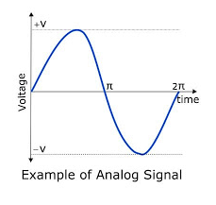
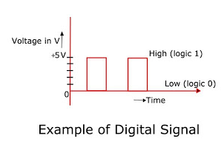
Analog and Digital Signals
Analog Signal
Digital Signal
Continuous
Infinite range of values
Represented by sine wave
Discrete
Finite range of values (2)
Represented by square wave
Example: The output voltage from an audio amplifier might be any one of the infinite values between -10V and +10V at any particular instant of time.
Other examples: Radio frequency transmitter and receivers, power supplies etc.
Digital circuits are often called switching circuits because the voltage levels in a digital circuit are assumed to be switched from one value to another instantaneously.
Eg: Digital thermometer
On- off switch

Slide 4
Logic Levels
Digital systems use the binary number system.
Two binary digits 0 and 1 are represented by two different voltage levels, LOW and HIGH.
Normally, 0 → 0V
1→ +5V
There are 2 types of logic systems:
Positive logic system: 1 →+5V (HIGH)
0 →0V (LOW)
Negative Logic System: 0 → +5V (HIGH)
1 → 0V (LOW)

Slide 5
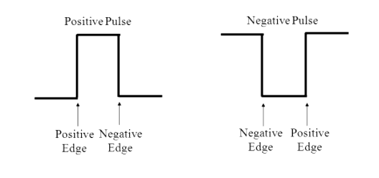
Pulse Waveforms
A pulse has two edges:
Leading edge :- For positive pulse: Positive going transition (Rising edge)
For negative pulse: Negative going transition (Falling edge)
Trailing edge:- For positive pulse: Negative going transition (Falling edge)
For negative pulse: Positive going transition (Rising edge)
Leading edge
Trailing edge
Leading edge
Trailing
edge

Slide 6
Binary Signals
It means two-states
1 and 0
true and false
on and off
A single “on/off”, “true/false”, “1/0” is called a bit
Example: Toggle switch
Computers makes use of binary signals as these signals can be represented with a transistor that is relatively easy to fabricate (in silicon) Millions of them can be put in a tiny chip

Slide 7
Logic Gates

Slide 8
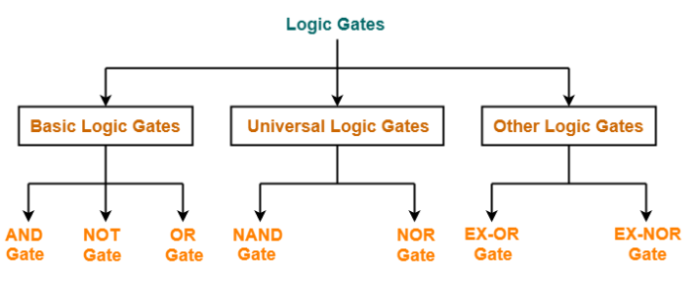
Logic Gates
Logic gates are the building blocks used to create digital circuits.
It is an electronic circuit that performs logical operations on one or more logical inputs to produce a single logical output.
Types of Logic Gates:
.

Slide 9
Notational methods for describing the behaviour of gates and circuits
There are four different, but equally powerful, notational methods for describing the behaviour of gates and circuits
Definition
Symbol
Boolean expression
Logic diagrams
Truth tables
Timing Diagram
Boolean expression: It is a mathematical equation showing the relationship between the input and the output variables. Eg: Y= A+B
Logic diagram: a graphical representation of a circuit representing a particular function..
– Each type of gate is represented by a specific graphical symbol.
Truth table: defines the function of a gate by listing all possible input combinations that the gate could encounter, and the corresponding output.
Timing diagram: A digital timing diagram is a representation of set of signals in the time domain as waveforms.

Slide 10
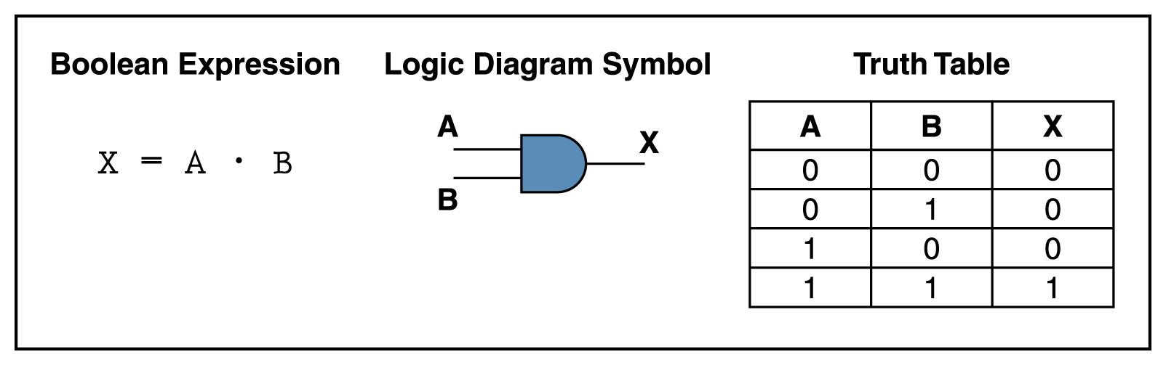
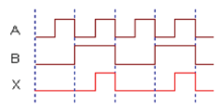
AND Gate( Multiplication function)
It is a digital electronic circuit which has 2 or more inputs and a single output where the output of AND gate is high when all inputs are high, otherwise the output will be low.
The expression X=A.B is read as “X equals A AND B.”
Timing Diagram

Slide 11
Review Questions:
What is the only input combination that will produce a HIGH at the output of a five-input AND gate?
– all 5 inputs = 1
What logic level should be applied to the second input of a two-input AND gate if the logic signal at the first input is to be inhibited(prevented) from reaching the output?
– A LOW input will keep the output LOW

Slide 12
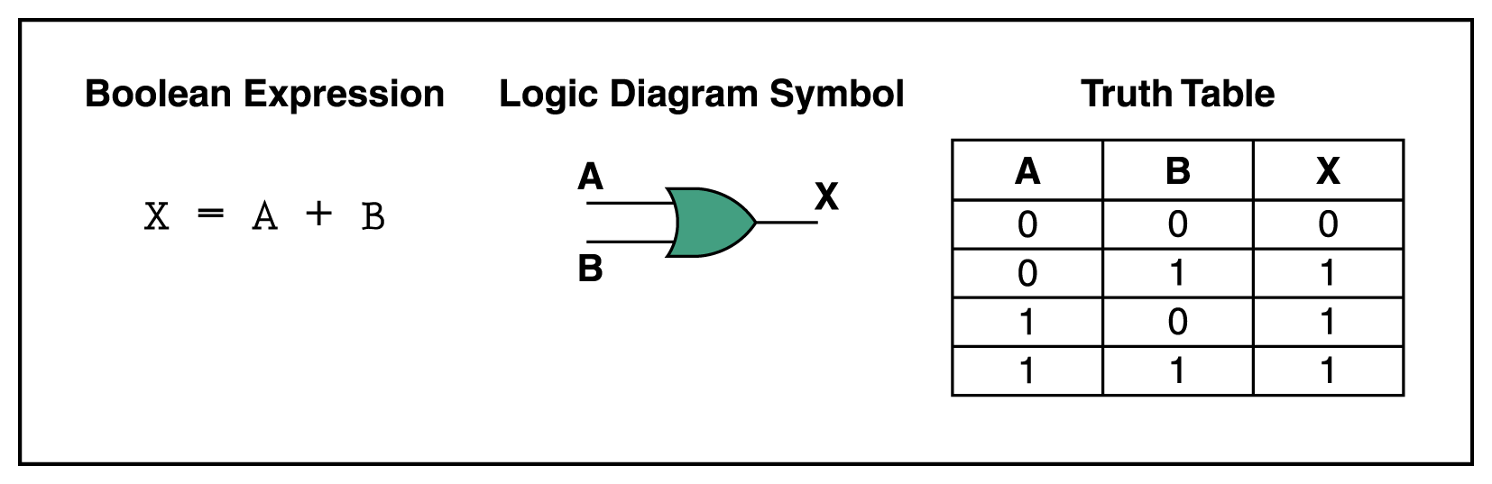
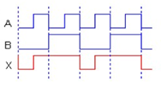
OR Gate (Logical Addition Function)
It is a digital electronic circuit which has 2 or more inputs and a single output where the output of OR gate is Low when all inputs are low, else output will be high.
The expression X=A+B is read as “X equals A OR B”
Timing Diagram

Slide 13
Review Questions:
What is the only set of input conditions that will produce a LOW output for any OR gate?
– all inputs LOW
Write the Boolean expression for a six-input OR gate
– X=A+B+C+D+E+F
If the A input in previous example is permanently kept at the 1 level, what will the resultant output waveform be?
– constant HIGH

Slide 14
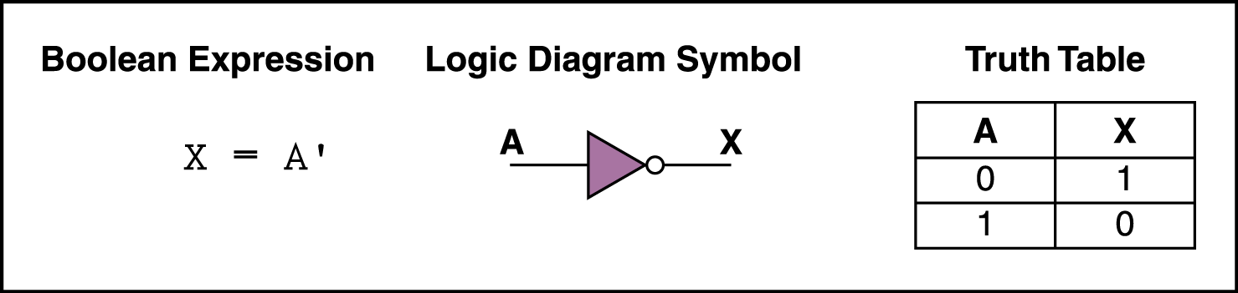

Not Gate (Inverter)
The inverter (NOT circuit) performs the operation called inversion or complementation.
The NOT operation changes one logic level to the opposite logical level. When the input is Low, the output is high. When the input is high, the output is low.
Timing Diagram

Slide 15
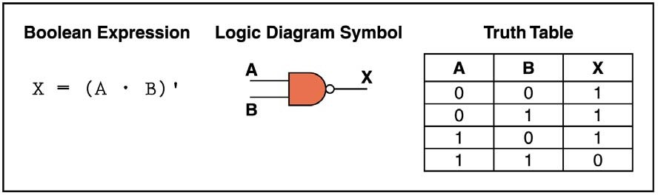

NAND Gate
NAND gate is of the popular logic circuit because it can be used as a universal gate; that is NAND gate can be used in combination to perform the AND, OR, and inverter operations.
It is constructed by attaching NOT Gate at the output of AND Gate, hence NAND Gate is called NOT- AND Gate.
The output of NAND gate is low when all inputs are high, else output is high.
Timing Diagram

Slide 16
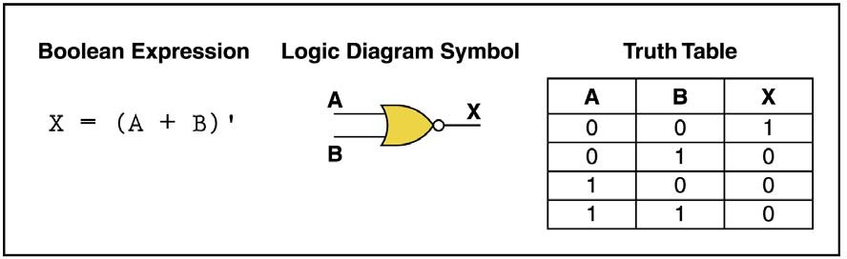

NOR Gate
NOR gate is also useful logical element because it can also be used as a universal gate.
It can be used in combination to perform the AND, OR and Inverter operations.
NOR Gate is the combination of NOT gate at the output of OR gate, hence NOR gate is type of NOT-OR gate.
The Output of NOR gate is high when all inputs are low otherwise the output is low.
Timing Diagram

Slide 17
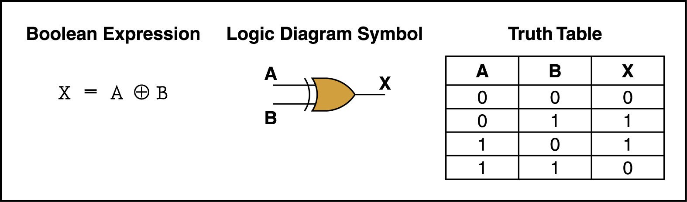
Exclusive- OR Gate
Exclusive-OR gate is a logical operation that outputs true only when inputs differ (one is true, the other is false).
If both inputs are Low or both are High then it produces the output Low or 0, otherwise it produces the High output.
The exclusive-OR gate has a graphical symbol similar to that of the OR gate, except for the additional curved line on the input side.

Slide 18
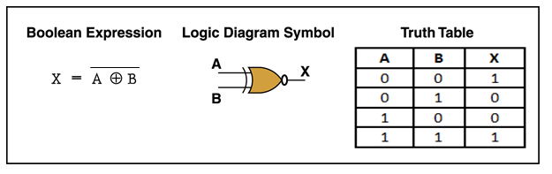
Exclusive-NOR Gate
The exclusive-NOR gate is the complement of the exclusive-OR gate, as indicated by small circle on the output side of the graphic symbol.
If both inputs are Low or both are High then it produces the output High or 1, otherwise it produces the Low output.

Slide 19
Universal Gates

Slide 20
NAND Gate
as
Universal Gate

Slide 21

NAND Gate as a NOT Gate
A
X = A. A = A
Truth Table
Input | Output
A | X
0 | 1
1 | 0

Slide 22

NAND Gate as an AND Gate
A B
A
B
X = A B = A B
NAND Gate
Inverter
Truth Table
Inputs |  | Output
A | B | X
0 | 0 | 0
0 | 1 | 0
1 | 0 | 0
1 | 1 | 1

Slide 23
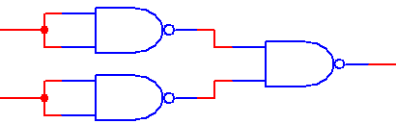
NAND Gate as an OR Gate
A
A
B
X = A B = A + B = A + B
B
Inverters
NAND Gate
Truth Table
Inputs |  | Output
A | B | X
0 | 0 | 0
0 | 1 | 1
1 | 0 | 1
1 | 1 | 1

Slide 24
NOR Gate
As
Universal Gate

Slide 25

NOR Gate as a NOT Gate
_{A + A = A}
(Before Bubble)
A
X = A
Truth Table
Inputs | Output
A | X
0 | 1
1 | 0

Slide 26
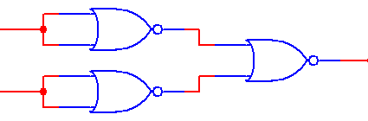
NOR Gate as an AND Gate
A
A
B
X = A + B = A B = A B
B
“Inverters”
NOR Gate
Truth Table
Inputs |  | Output
A | B | X
0 | 0 | 0
0 | 1 | 0
1 | 0 | 0
1 | 1 | 1

Slide 27

NOR Gate as an OR Gate
A + B
A
X = A + B = A + B
B
NOR Gate
“Inverter”
Truth Table
Inputs |  | Output
A | B | X
0 | 0 | 0
0 | 1 | 1
1 | 0 | 1
1 | 1 | 1

Slide 28

Describing Logic Circuits Algebraically
Any logic circuit, no matter how complex, can be completely described using the three basic Boolean operations: OR, AND, NOT.
Example: Logic circuit with its Boolean expression

Slide 29
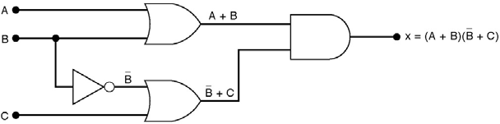
Example:
Draw the circuit diagram to implement the expression:
x = ( A + B )( B + C )

Slide 30
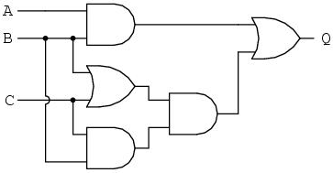
Activity 1:
1. Determine the output value of the following logic circuit:

Slide 31
Activity 2:
1. Draw the circuit diagram to implement the expression:
X = (A.B)+C

Slide 32
Applications of Logic Gates
NAND Gates are used in Burglar alarms and buzzers.
They are basically used in circuits involving computation and processing.
They are also used in push button switches. E.g. Door Bell.
They are used in the functioning of street lights.
AND Gates are used to enable/inhibit the data transfer function.

Slide 33
Laws of Boolean Algebra

Slide 34
Boolean Algebra
Boolean algebra is the mathematics of digital logic. It is a system for the manipulation of variables that can have one of two values.
In formal logic, these values are “true” and “false.”
In digital systems, these values are “on” and “off,” 1 and 0, or “high” and “low.”
Boolean expressions are created by performing operations on Boolean variables.
Common Boolean operators include AND, OR, and NOT.

Slide 35
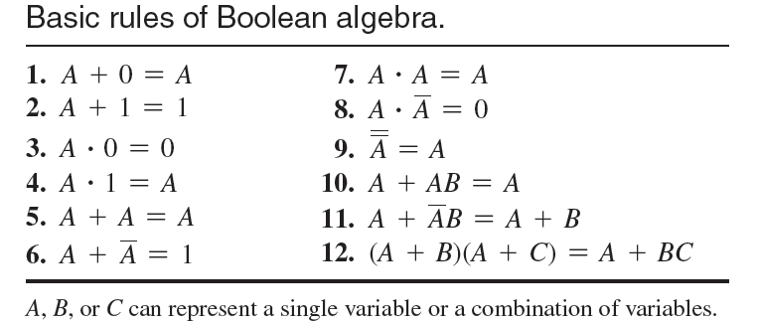
Rules of Boolean Algebra

Slide 36
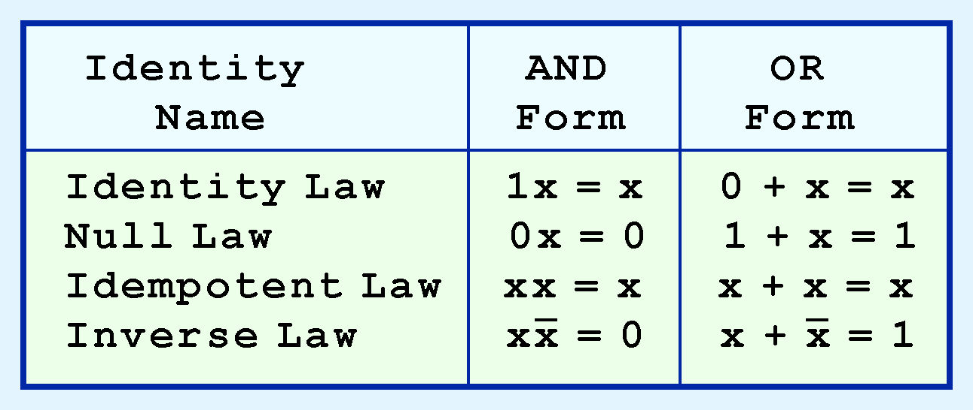
Contd…
Most Boolean identities have an AND (product) form as well as an OR (sum) form. We give our identities using both forms. Our first group is rather intuitive:

Slide 37
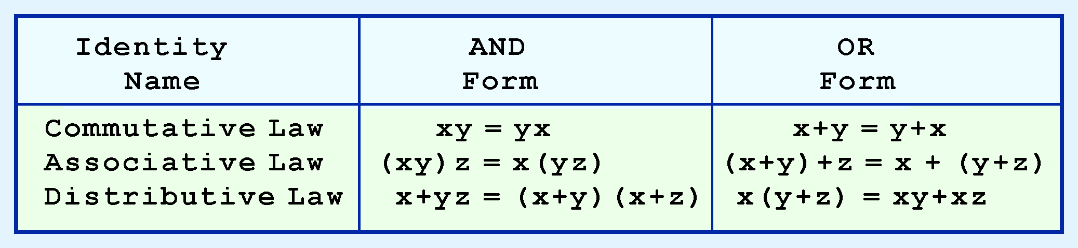
Contd…
Our second group of Boolean identities should be familiar to you from your study of algebra:

Slide 38
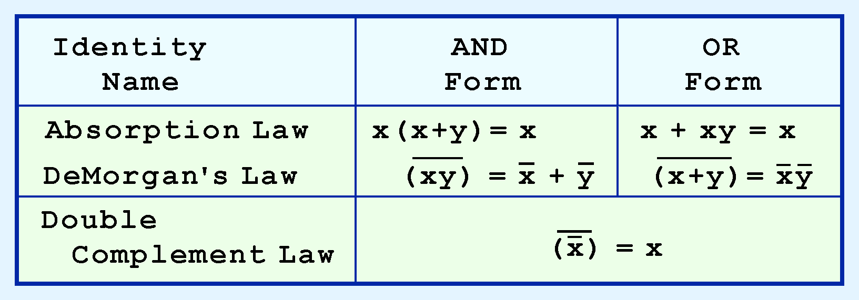
Contd…
Our last group of Boolean identities are perhaps the most useful.
If you have studied set theory or formal logic, these laws are also familiar to you.

Slide 39

De Morgan’s Theorems
Theorem 1: A.B = A+B
Theorem 2: A+B = A.B
De Morgan’s Theorem is very useful in digital circuit design
It allows ANDs to be exchanged with ORs by using invertors
De Morgan’s Theorem can be extended to any number of variables
Remember: “Break the bar, change the operator”

Slide 40

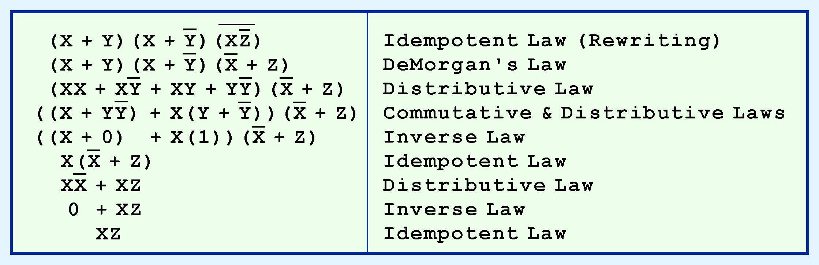
Contd…
We can use Boolean identities to simplify the function:
as follows:

Slide 41
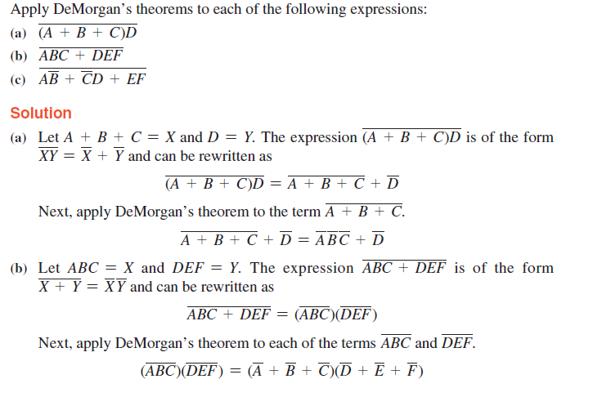
Logic Simplification Using Boolean Algebra

Slide 42
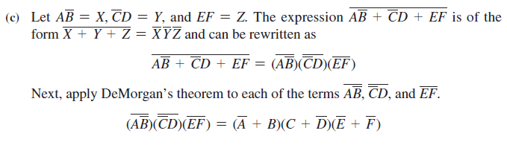
Contd.

Slide 43
Example1
Example1: Using Boolean algebra techniques, simplify this expression:
AB + A(B + C) + B(B + C)
Step 1: Apply the distributive law to the second and third terms in the expression, as follows:
AB + AB + AC + BB + BC
Step 2: Apply rule 7 (BB = B) to the fourth term.
AB + AB + AC + B + BC
Step 3: Apply rule 5 (AB + AB = AB) to the first two terms.
AB + AC + B + BC
Step 4: Apply rule 10 (B + BC = B) to the last two terms.
AB + AC + B
Step 5: Apply rule 10 (AB + B = B) to the first and third terms.
B + AC

Slide 44
Example 2
Example 2: Simplify the following Boolean expression: [A B (C + B D) + A B] C
Apply the distributive law to the terms within the brackets.
Step 1: (ABC + ABBD + A B)C
Step 2: Apply rule 8 (BB = 0) to the second term within the parentheses.
(ABC + A . 0 . D + A B) C
Step 3: Apply rule 3 (A . 0 . D = 0) to the second term within the parentheses.
(ABC + 0 + A B) C
Step 4: Apply rule 1 (drop the 0) within the parentheses.
(ABC + A B) C

Slide 45
Contd.
Step 5: Apply the distributive law.
ABCC + A B C
Step 6: Apply rule 7 (CC = C) to the first term.
ABC + A B C
Step 7: Factor out BC.
B C (A + A)
Step 8: Apply rule 6 (A + A = 1).
BC . 1
Step 9: Apply rule 4 (drop the 1).
B C

Slide 46
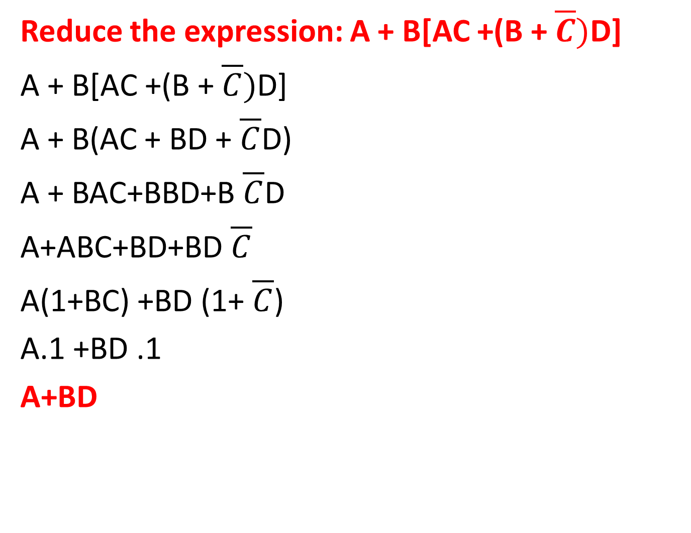
Example 3
Reduce the expression: A + B[AC +(B + $\overline{C})$D]
A + B[AC +(B + $\overline{C})$D]
A + B(AC + BD + $\overline{C}$D)
A + BAC+BBD+B $\overline{C}$D
A+ABC+BD+BD $\overline{C}$
A(1+BC) +BD (1+ $\overline{C}$)
A.1 +BD .1
A+BD

Slide 47
Activity 1
Apply De Morgan’s theorem to reduce the following expressions:
F = AB + A + AB
F = (A+B) (C+D)
F= (B+BC) (B+BC)(B+D)
Show that ABC+B+BD+ABD+AC = B+C

Slide 48
Any
Query ?

Slide 49
Thanks

